Slide 1
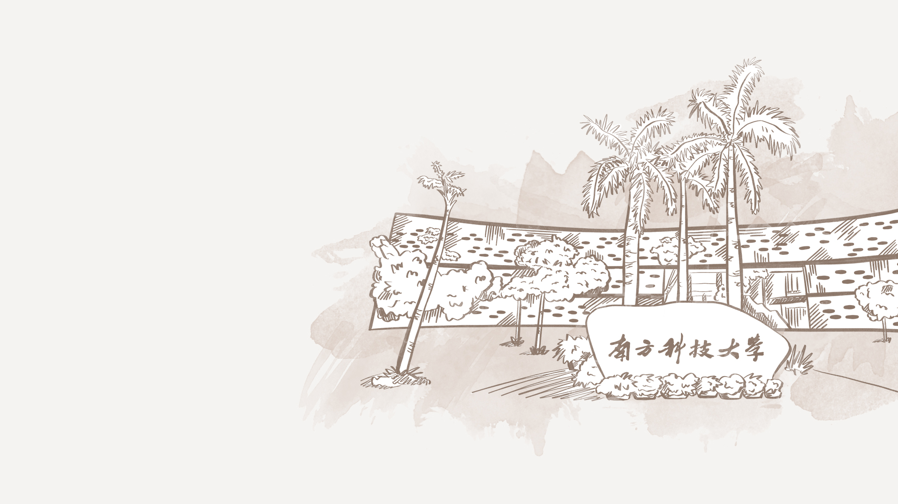

A Sand County Almanac
Group 2 冯柏钧 冯添期 田存鑫

Slide 2



01
Part I A Sand County Almanac
January to June
冯柏钧

Slide 3

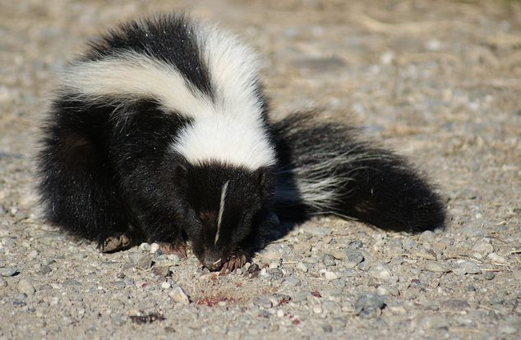
January
Skunk

Slide 4
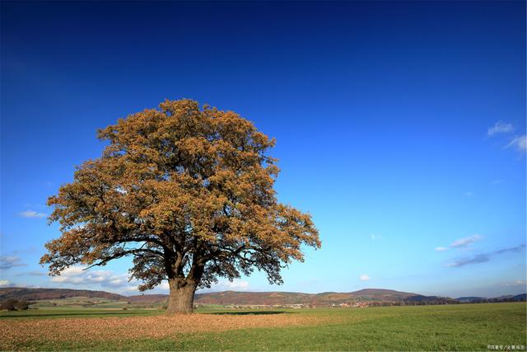
February
An oak tree

Slide 5
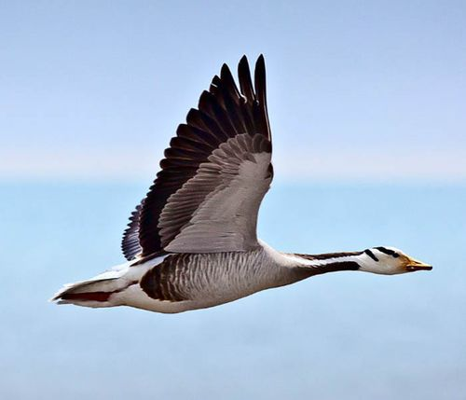
March
Geese

Slide 6
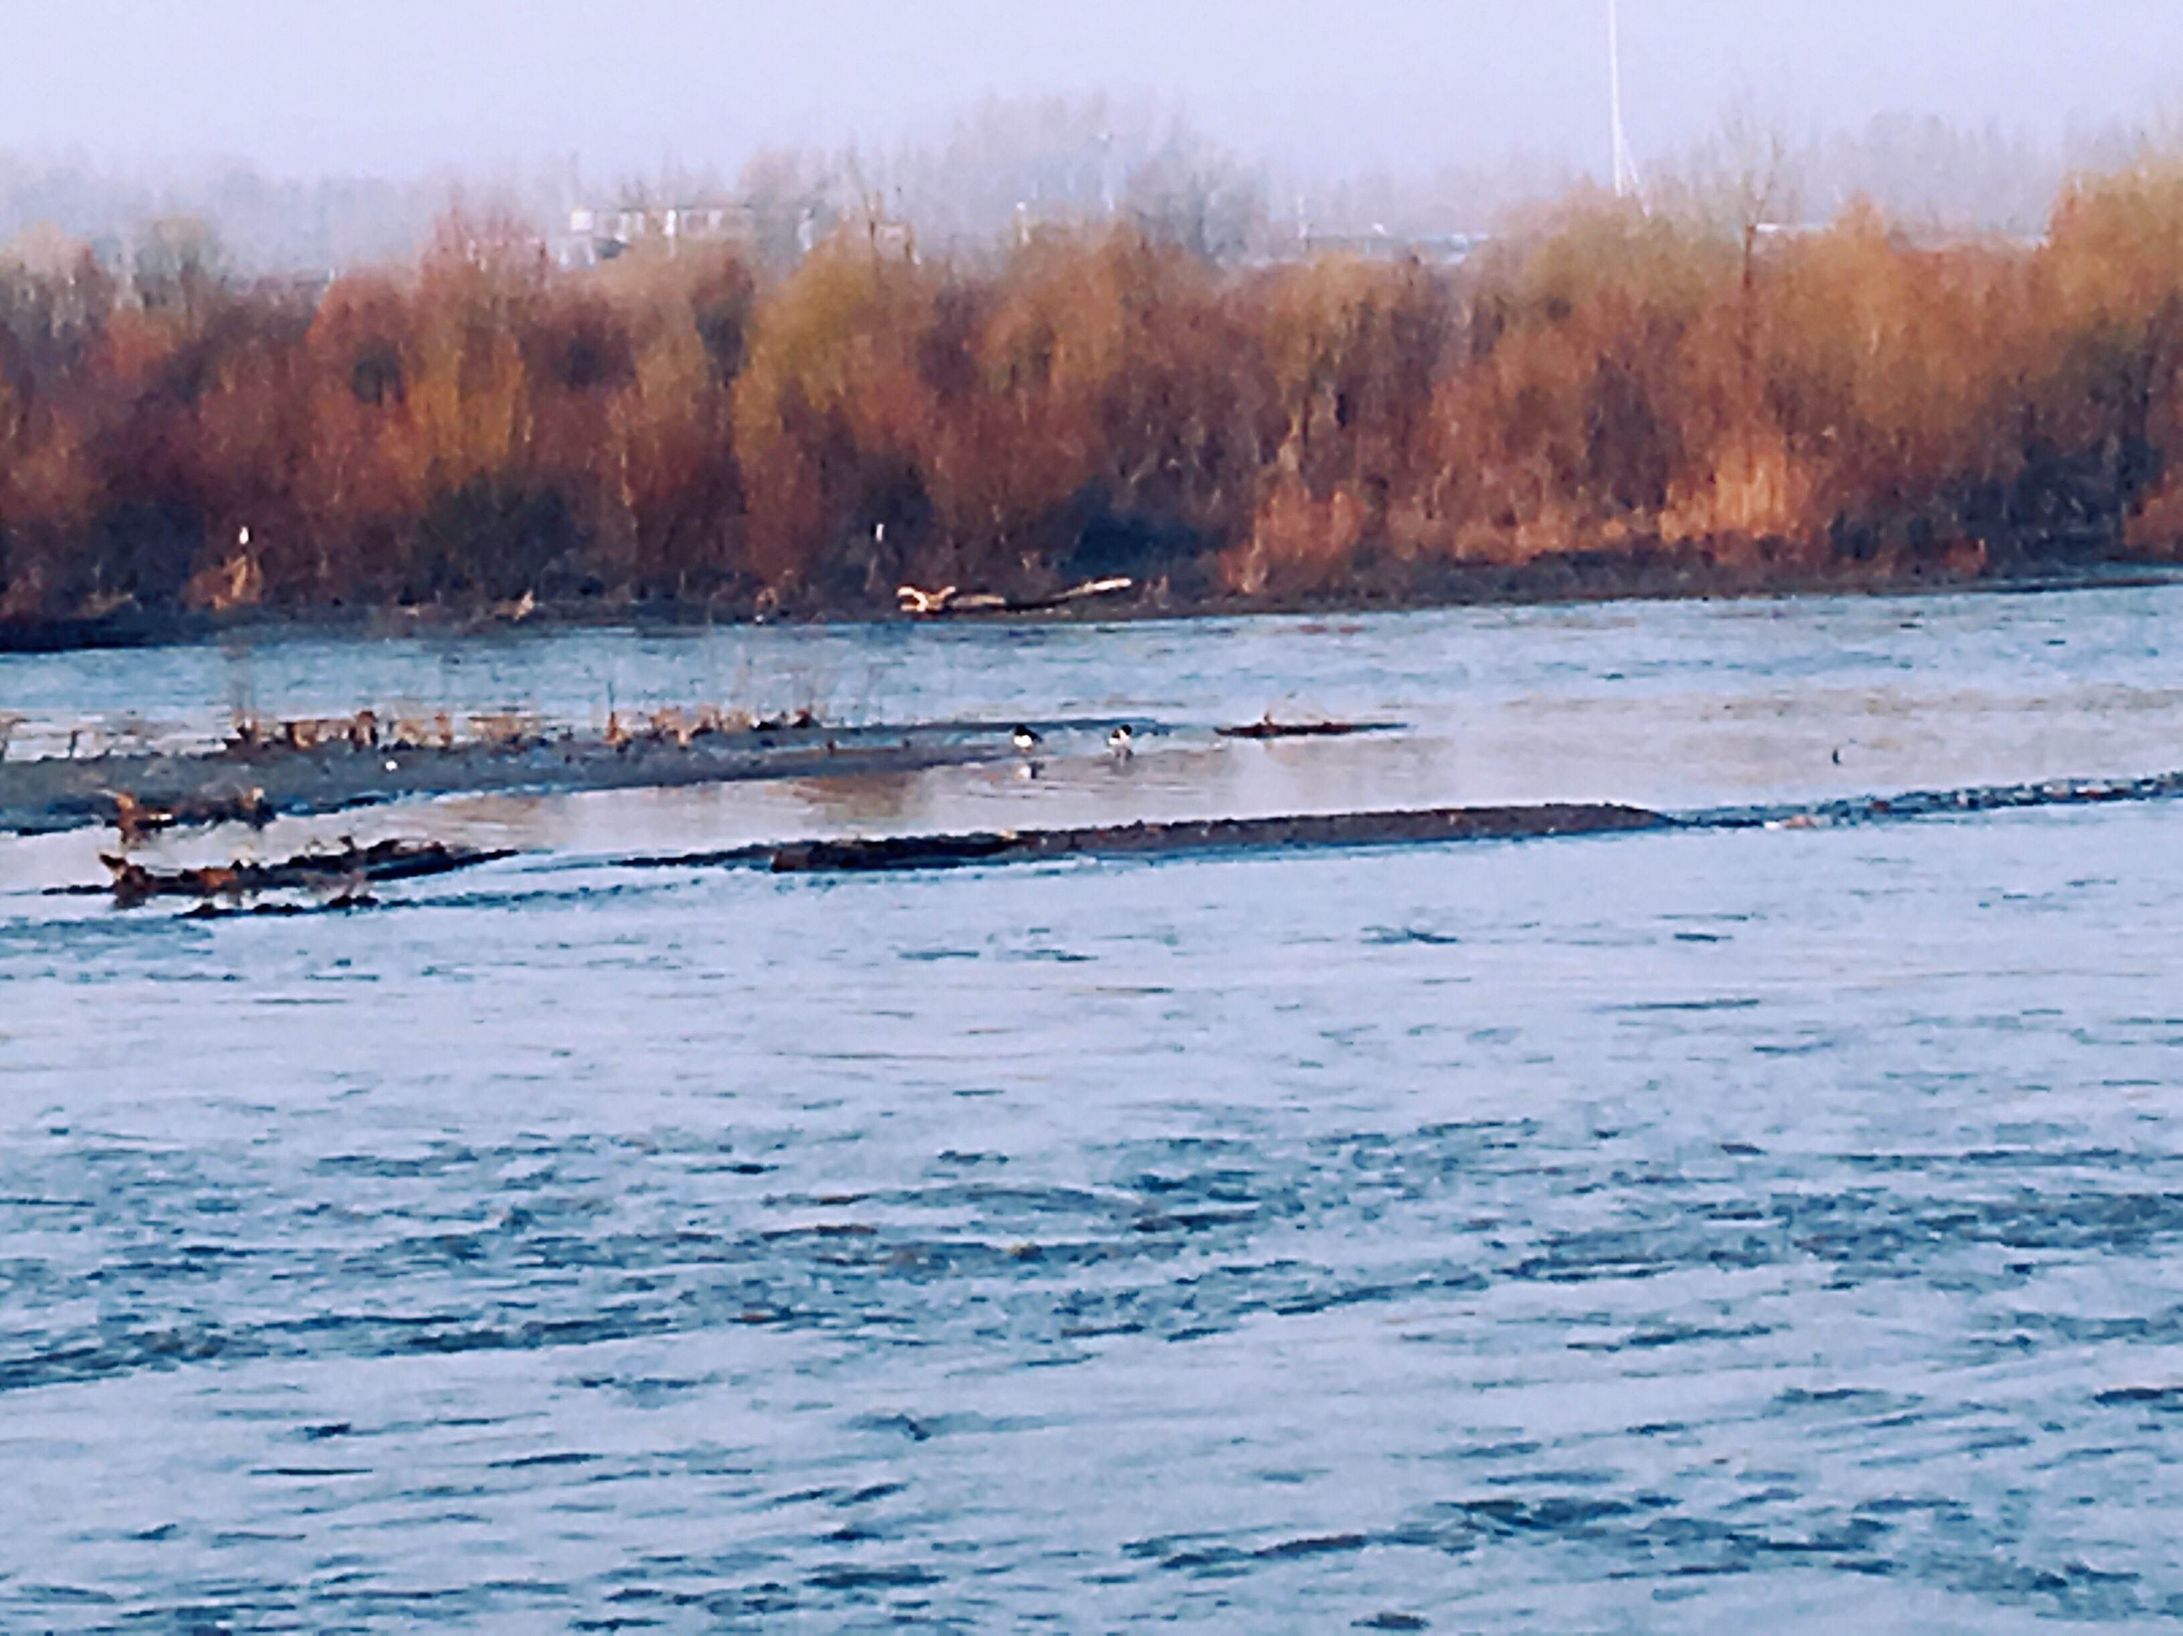
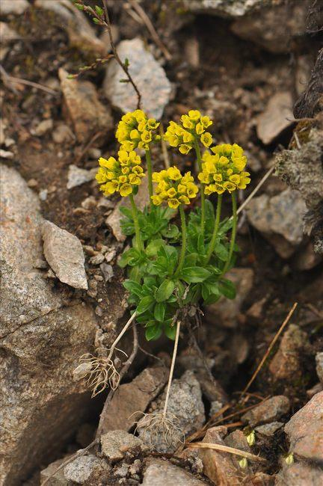
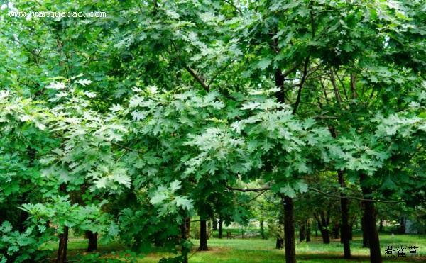
April
Spring tide
Draba
Bur oak

Slide 7
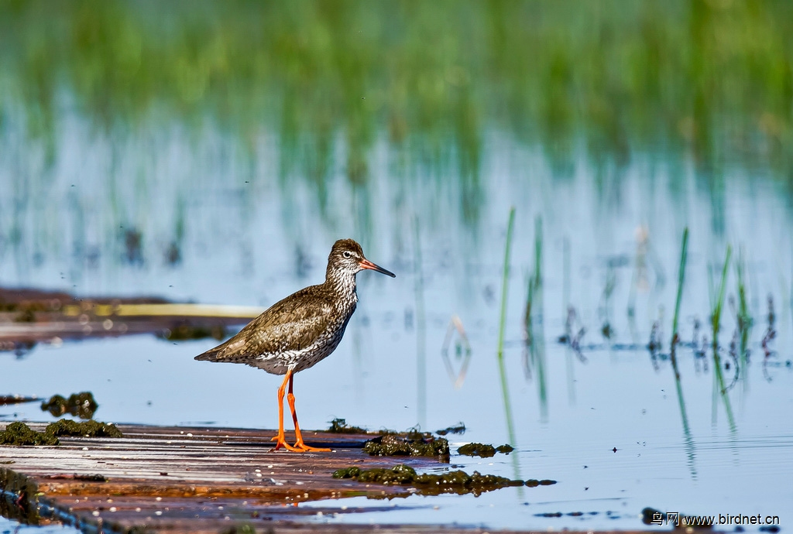
May
Teeter-snipe

Slide 8
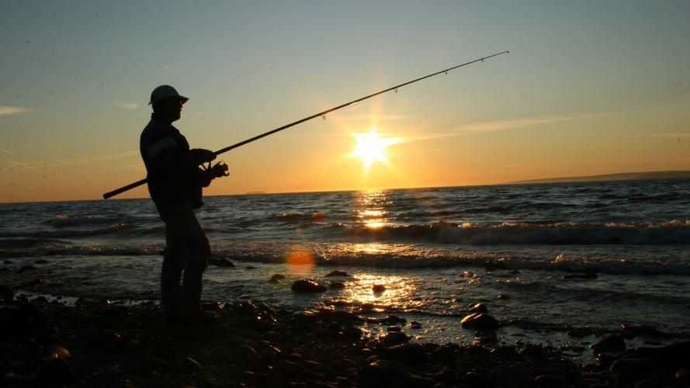
June
Fishing

Slide 9
Brief Summary
Why to write?
The inspiration and motivation

Slide 10
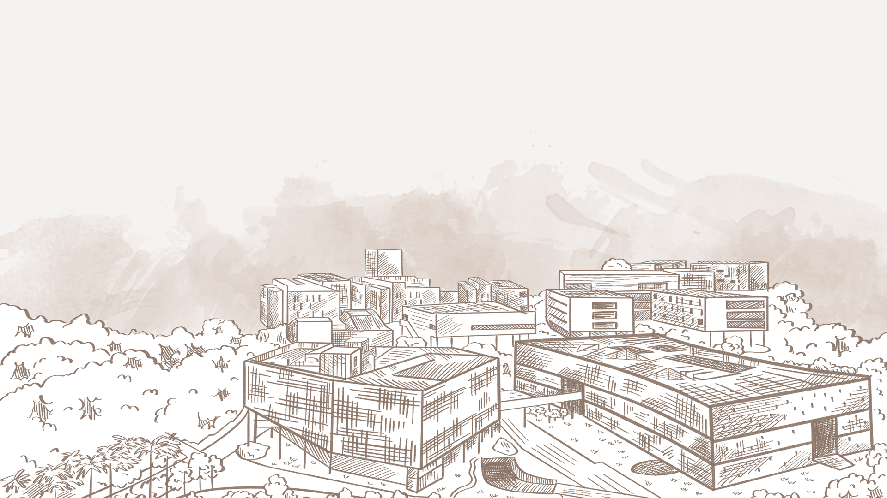
Thanks for
Your listening and watching!

